Slide 1


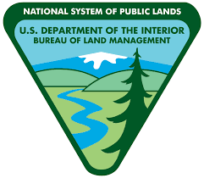



Effects of Biological Soil Crust Cover on Rainfall Runoff
Arizona/NASA Space Grant Symposium
Sophia Dixon
Dr. Jason Williams, USDA ARS, SWRC
Grand Staircase Escalante National Monument, UT

Slide 2
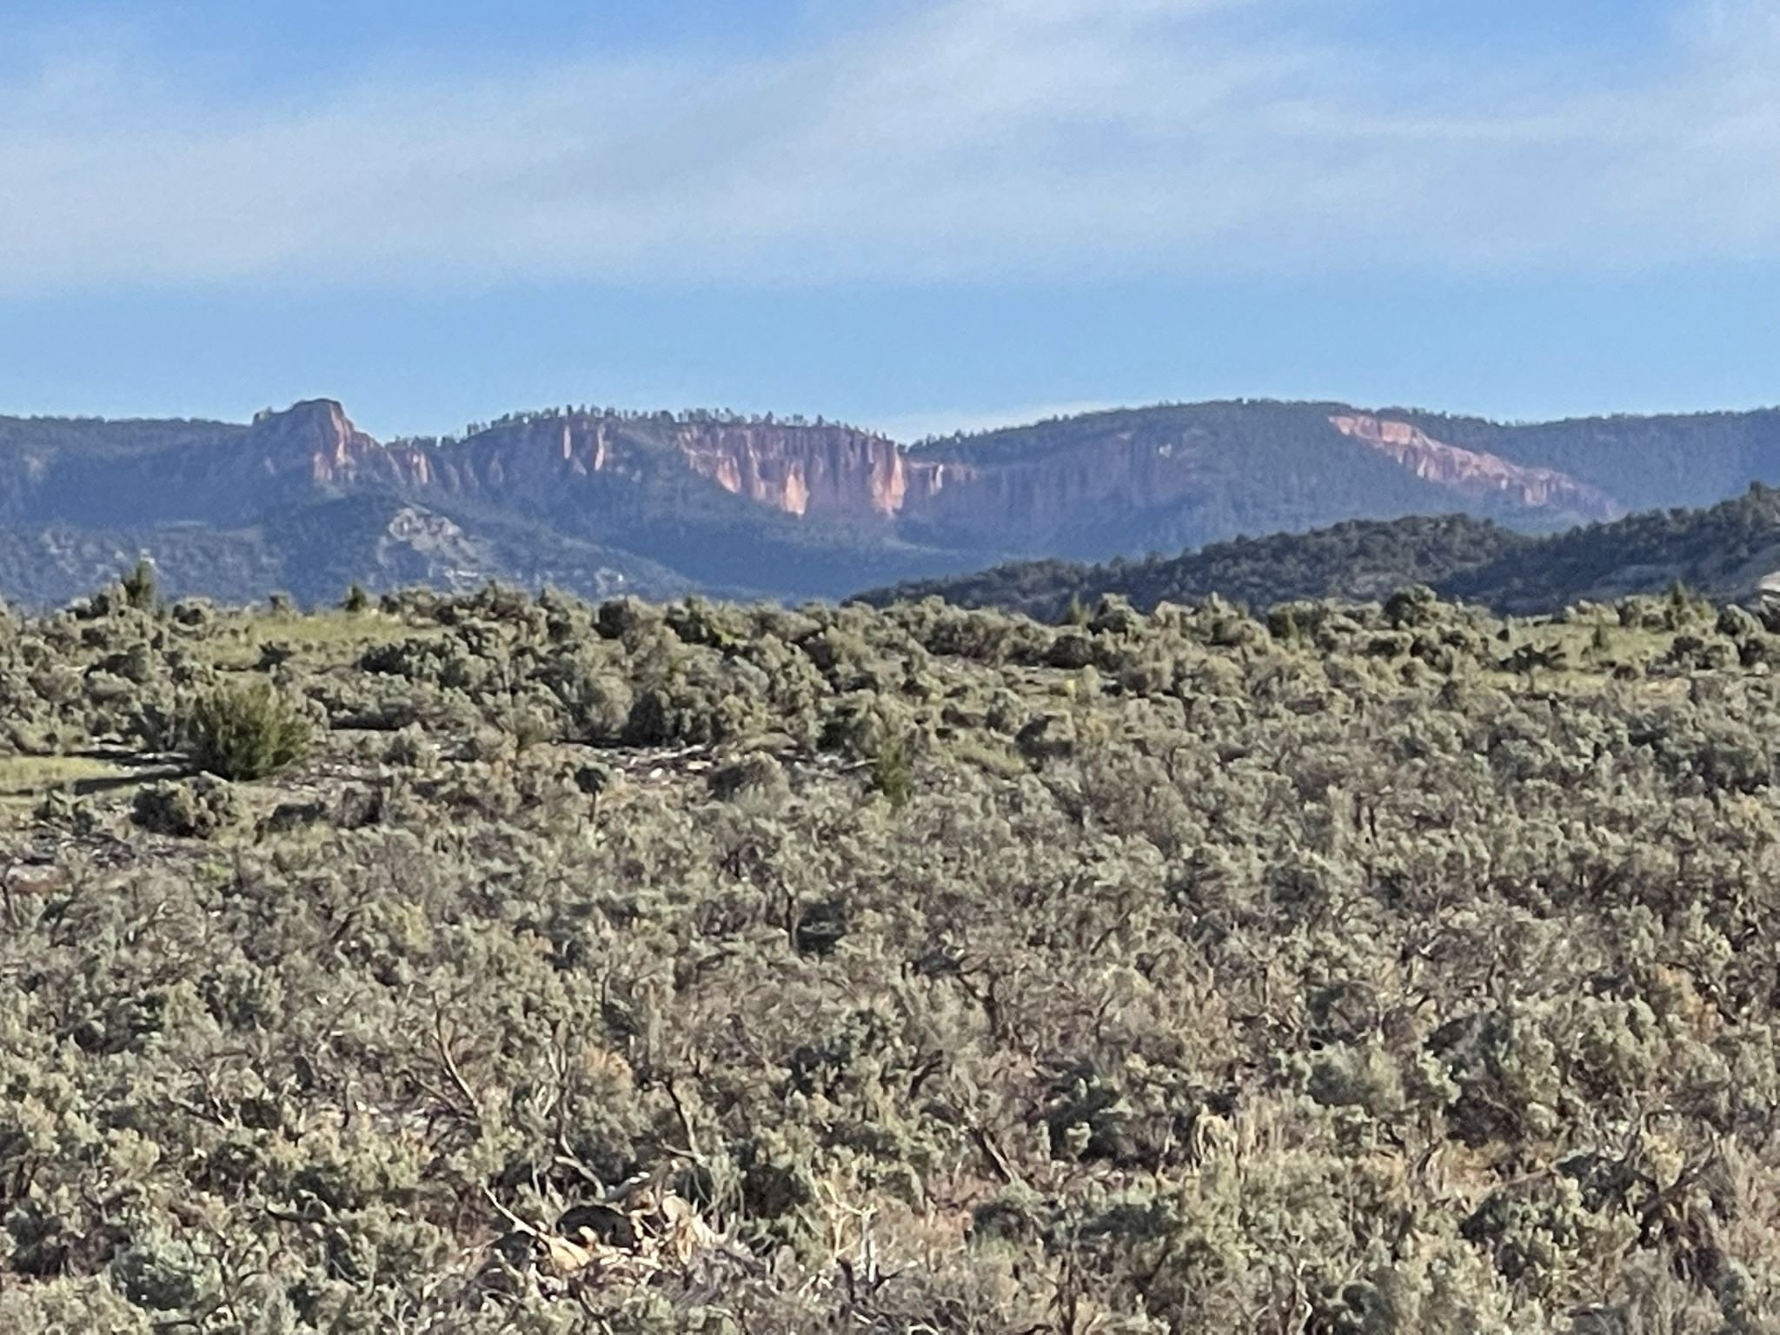
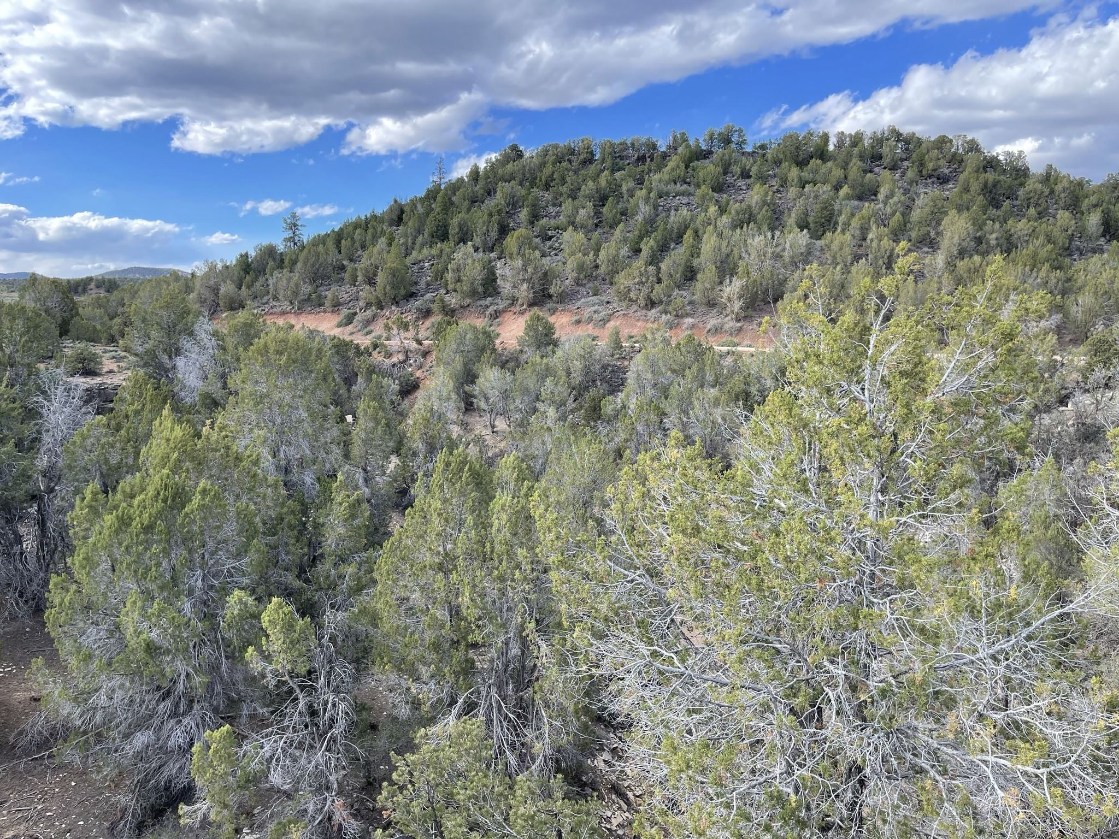
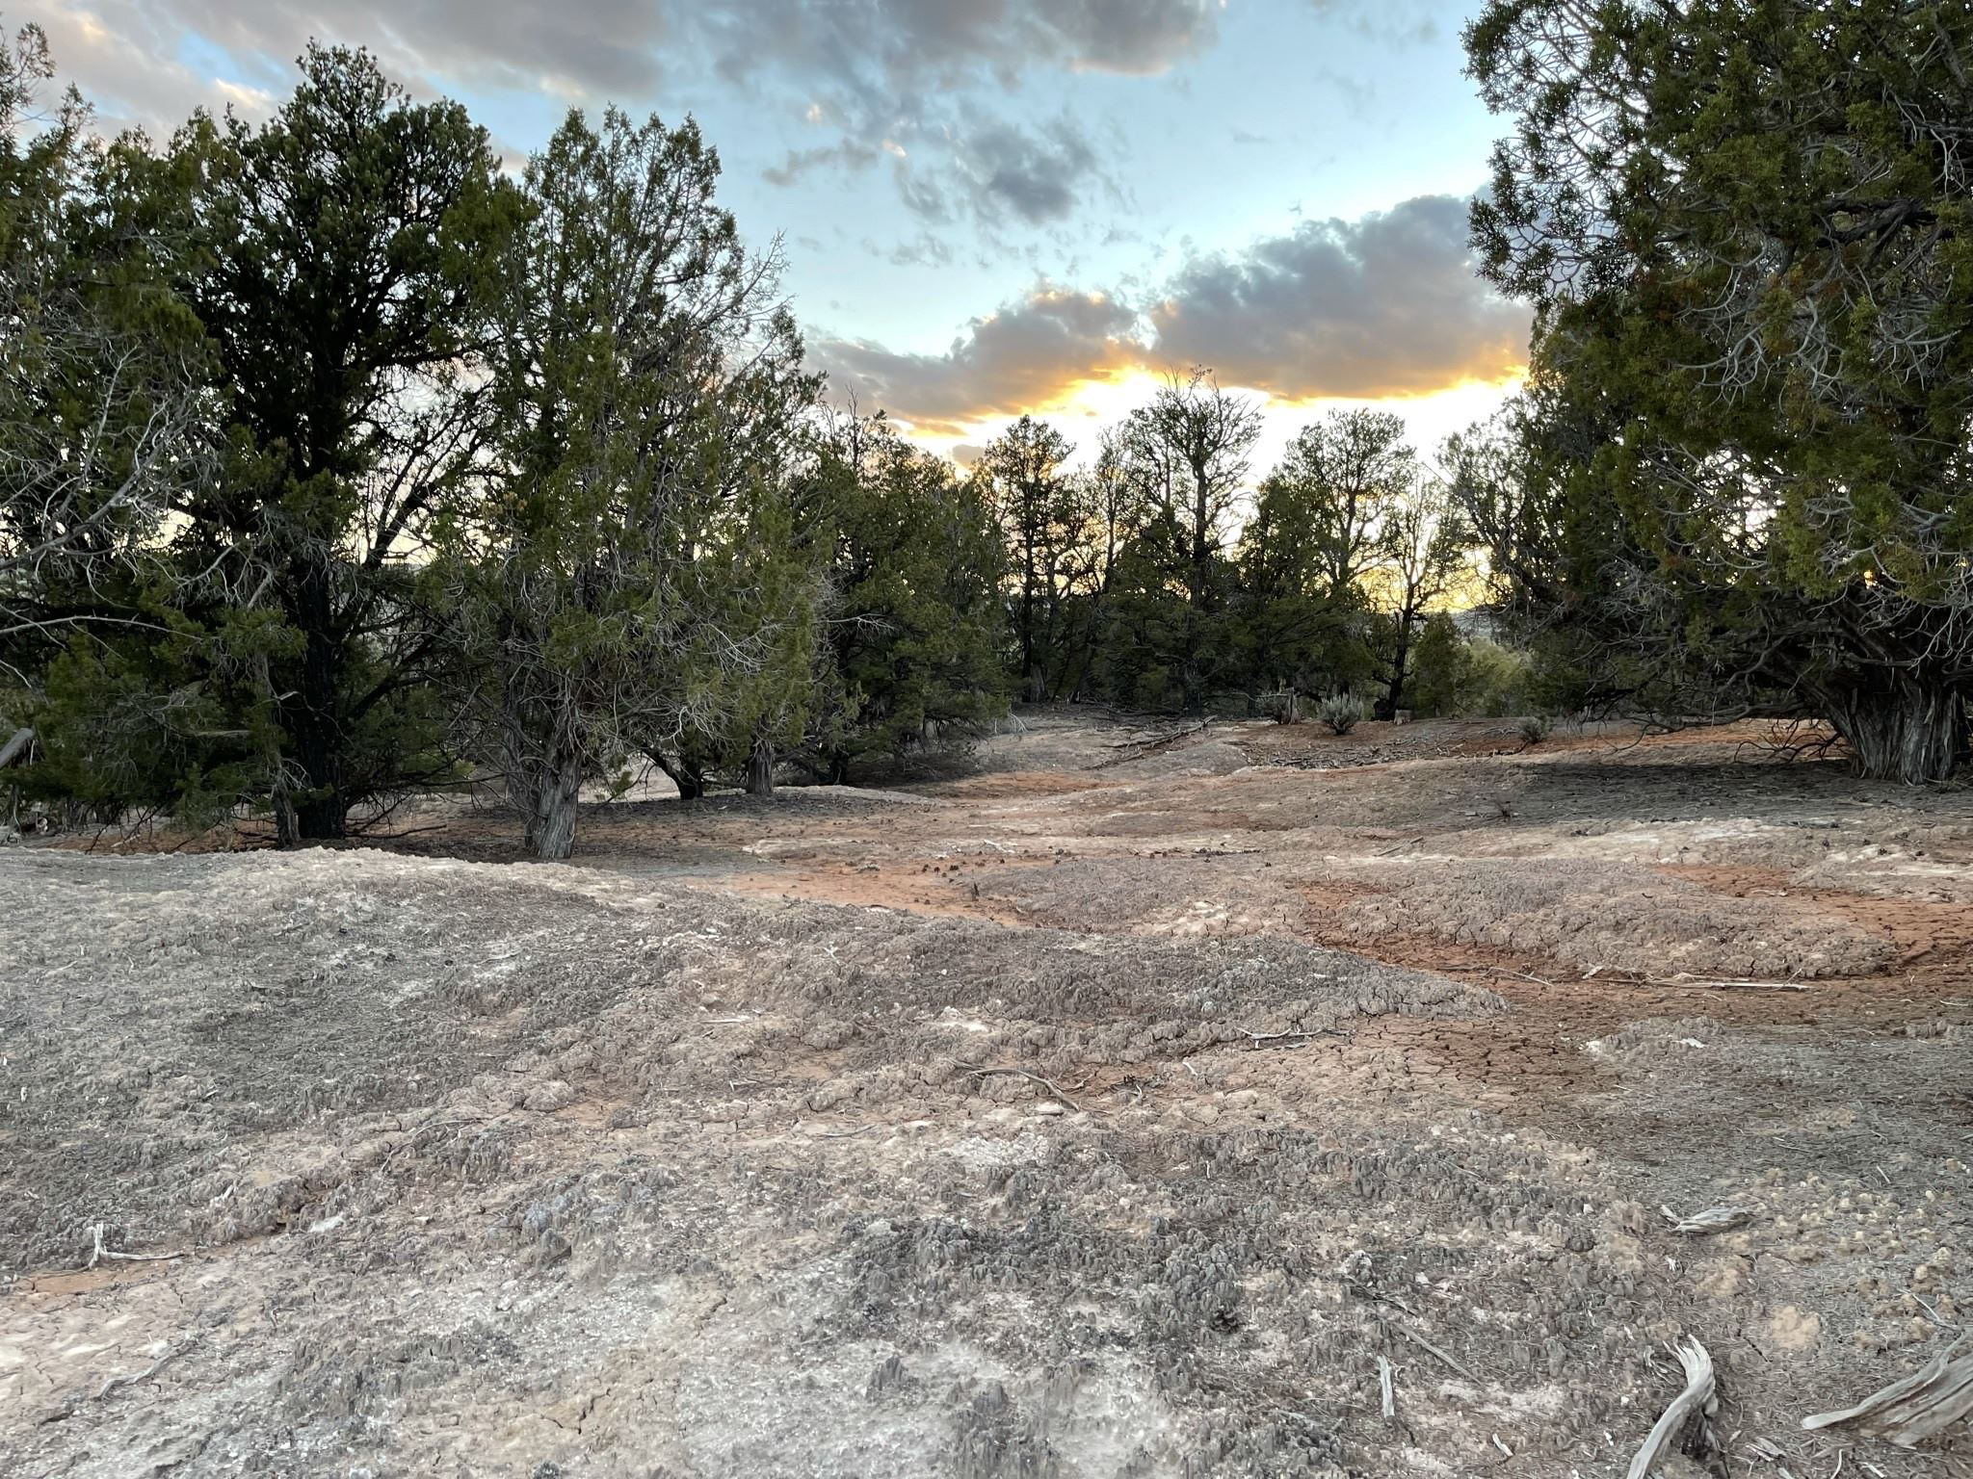
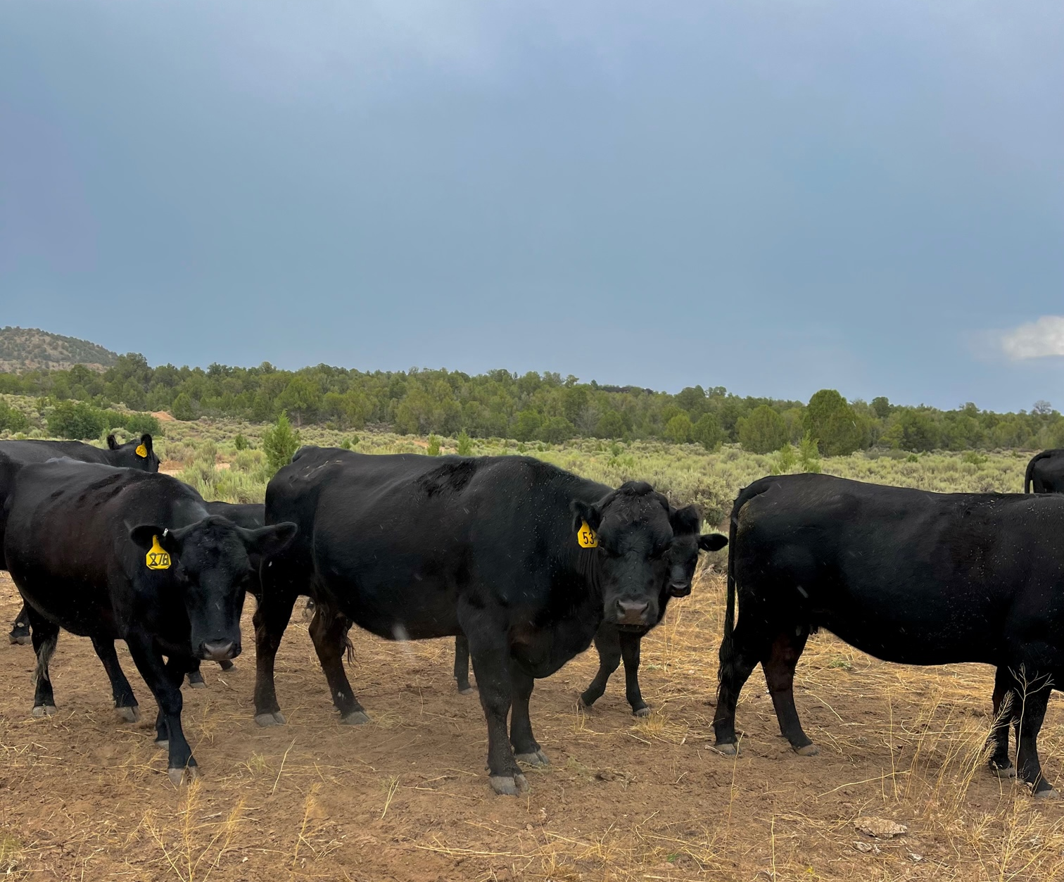
Grand Staircase Escalante National Monument
Southern Utah
Managed by Bureau of Land Management
  Cultural resources
  Ecological resources
  Recreation
  Wildlife habitat
  Cattle grazing

Slide 3
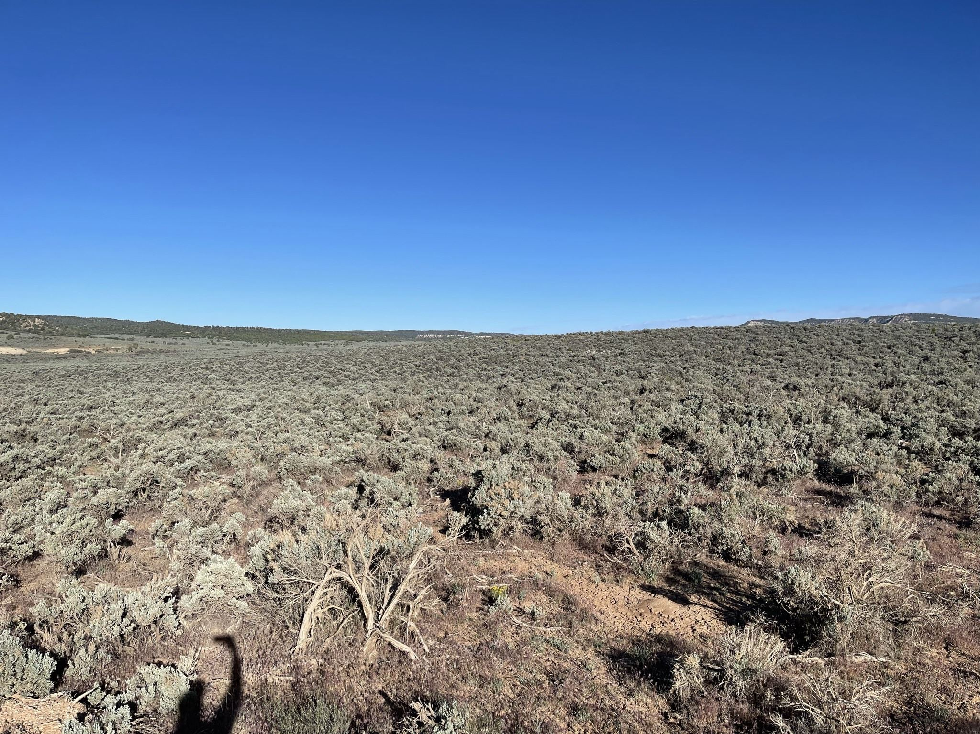
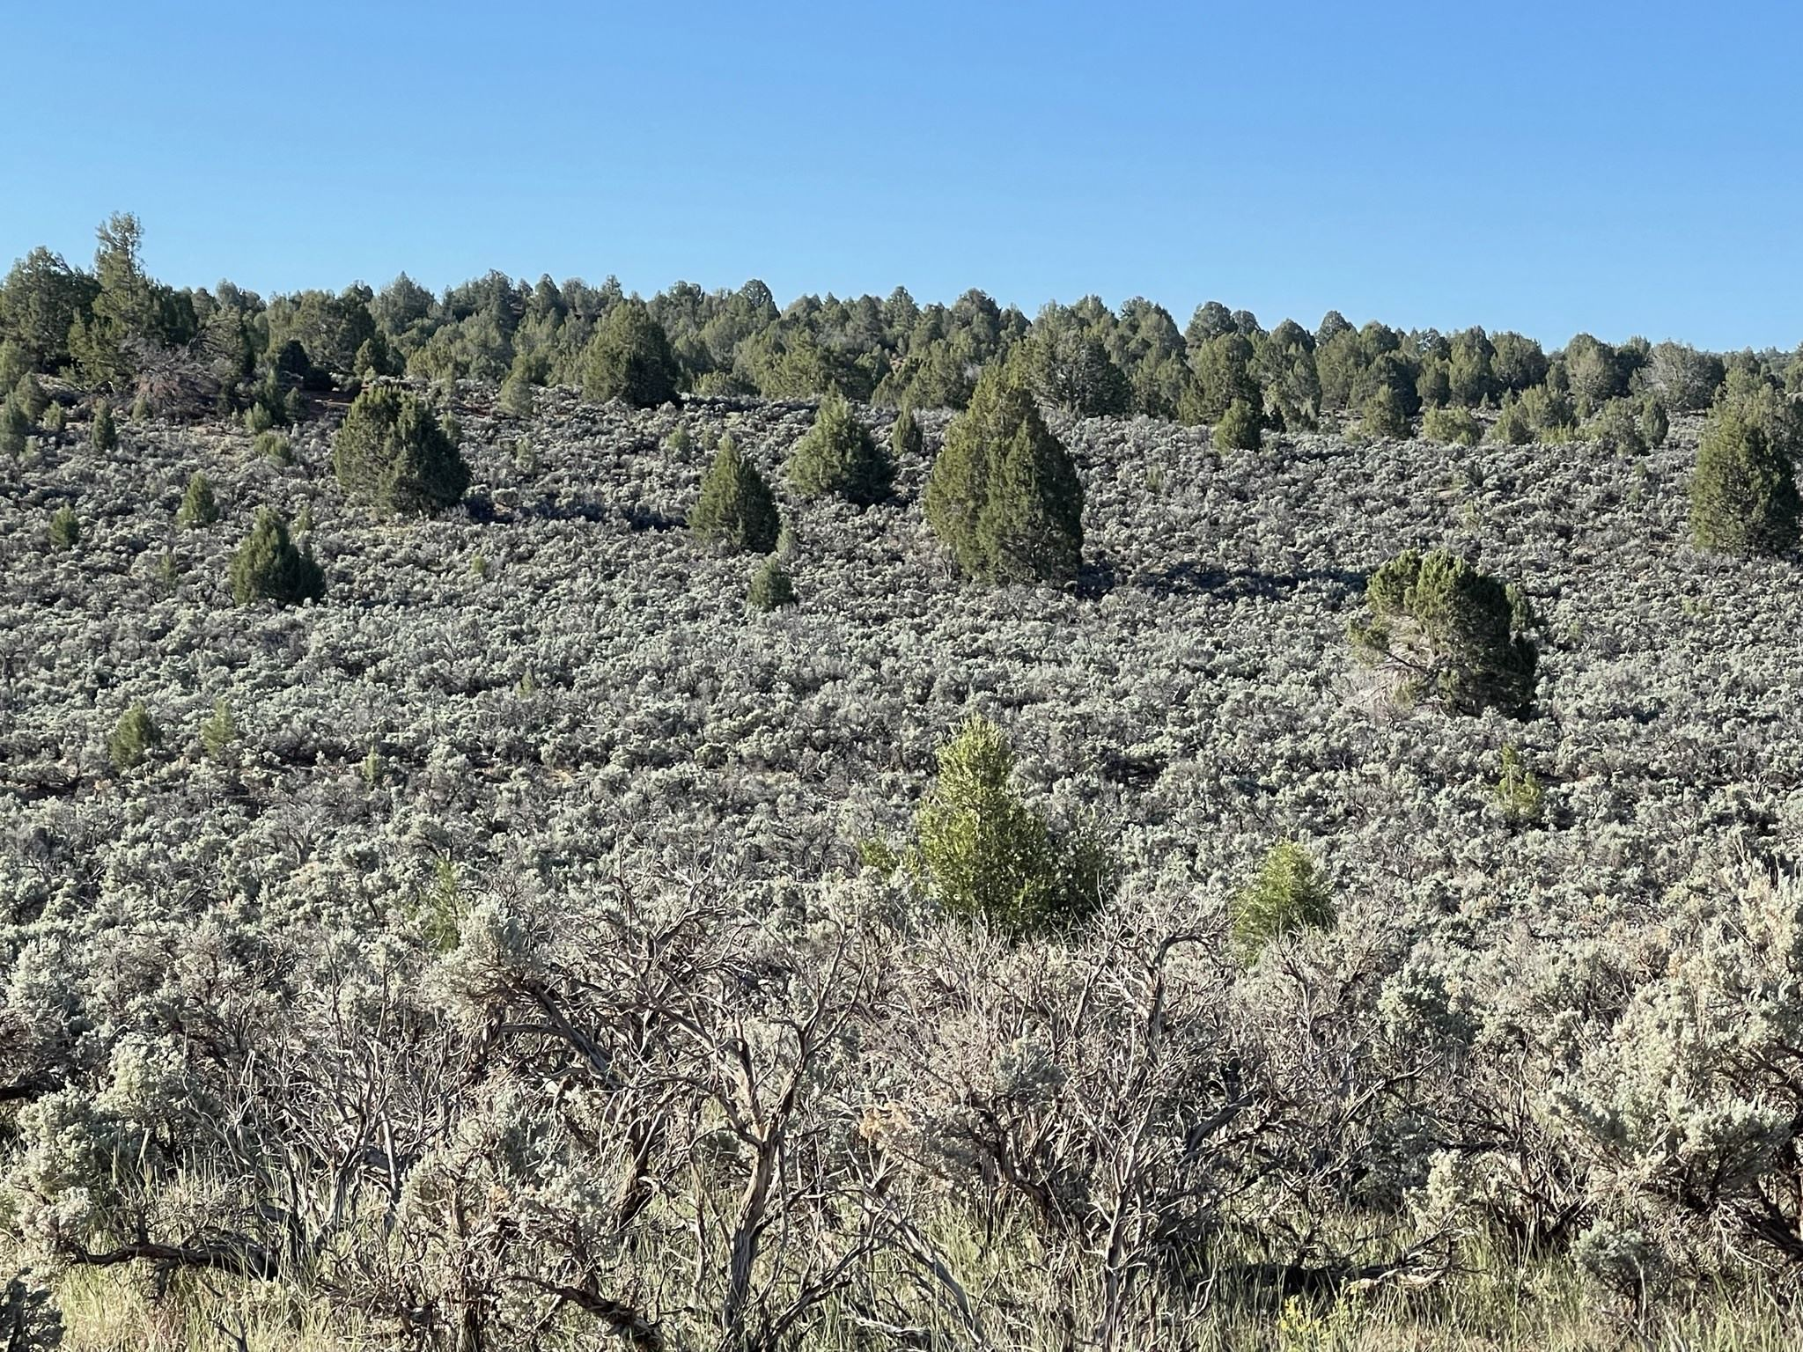
Pinyon Juniper Encroachment
Pinyon-juniper (PJ) encroachment into sagebrush steppe is an issue in the southwest and GSENM
  Overgrazing
  Fire suppression
  Climate change
BLM is considering tree removal to restore natural landscape
Role of SWRC: evaluate vegetation, soil conditions, and hydrologic function to compare to treated areas

Slide 4
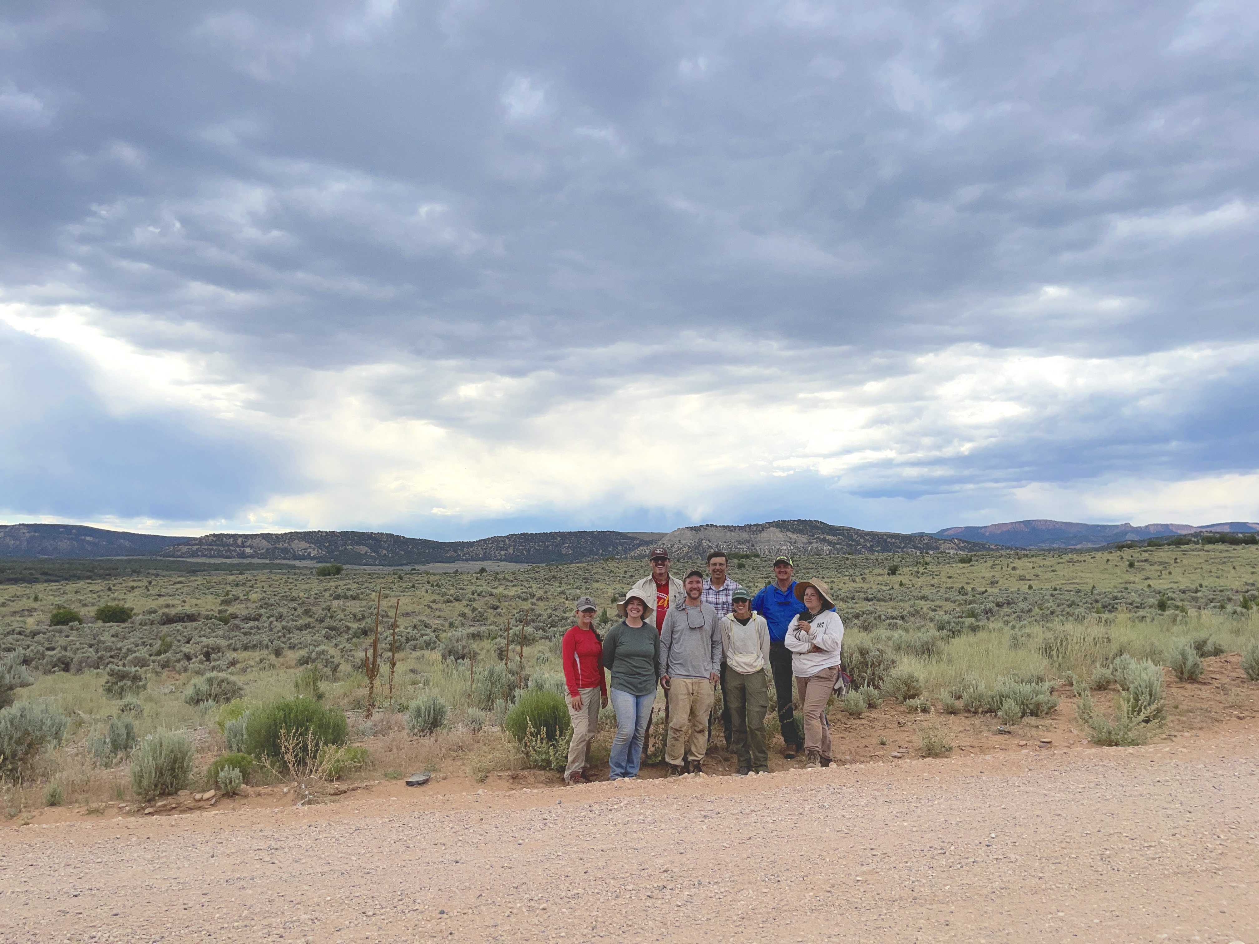
Research Question
How does biological soil crust cover influence rainfall runoff and erosion in woodland interspaces?

Slide 5
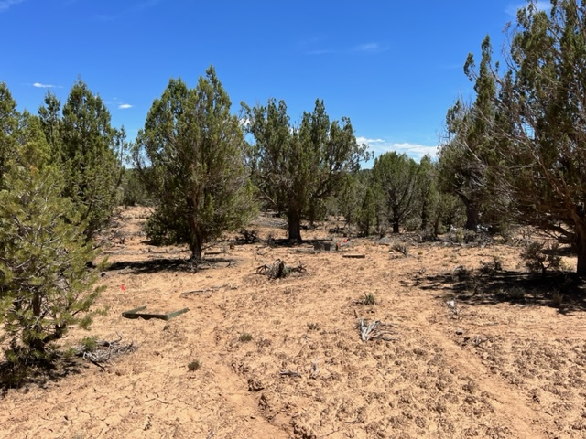
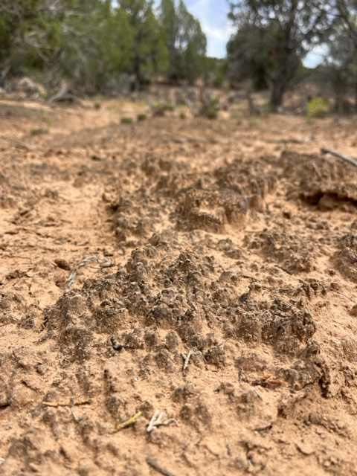
Biological Soil Crust
Runoff: flow of water across land surface
Erosion: removal and transport of weathered sediment by natural forces
Biological soil crust (crust): community of cyanobacteria, fungi, lichens, and algae living on the soil surface
Crust is common throughout GSENM
Crust often decreases runoff
Contradictory findings on crust in sandy soils

Slide 6
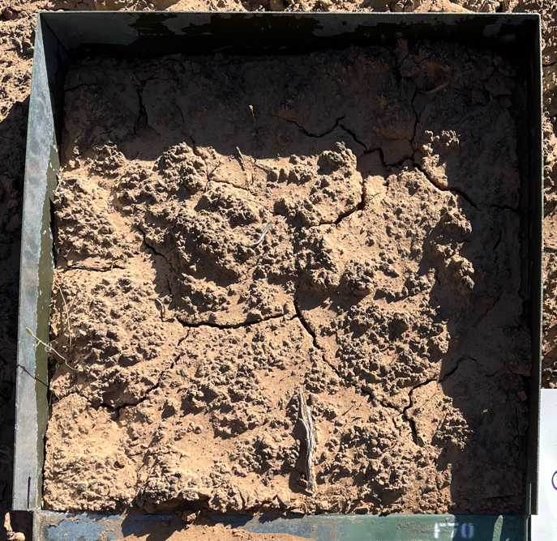
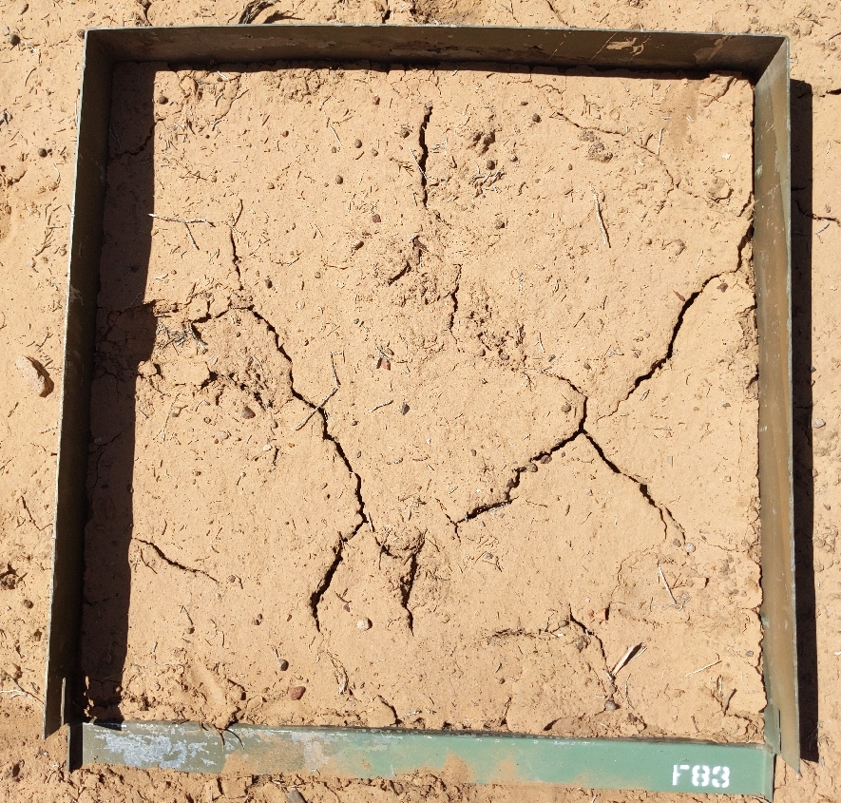
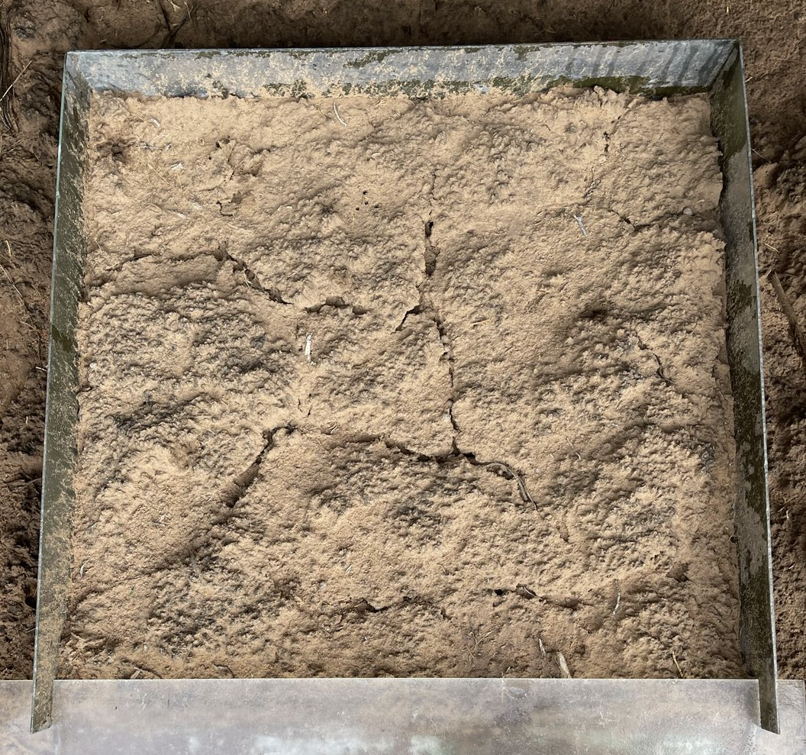
Experimental Design
Twelve 0.5 m² plots
Interspaces of a PJ woodland
Ranged from 0% to approximately 72% crust

Slide 7
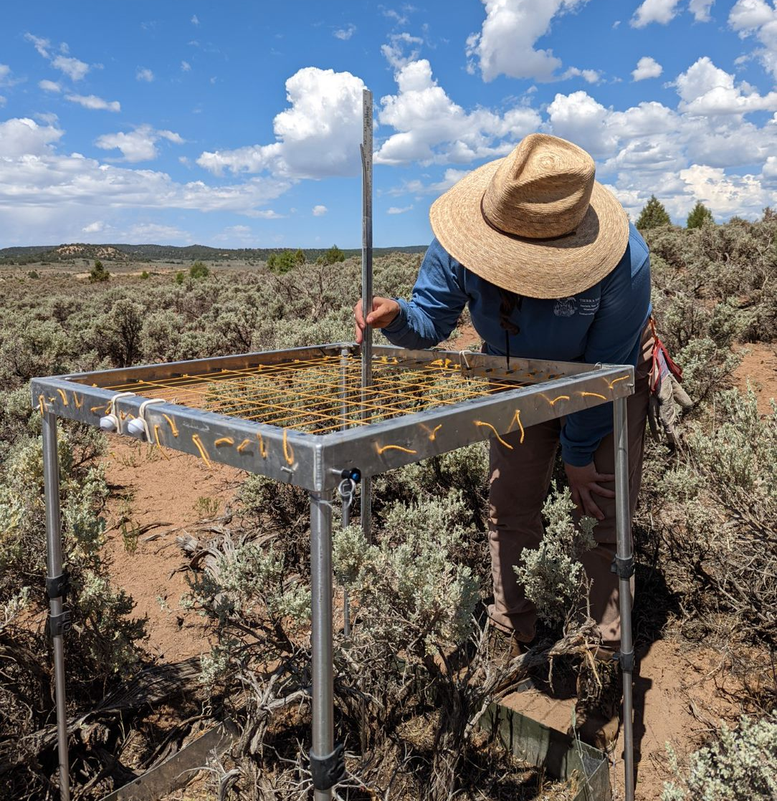
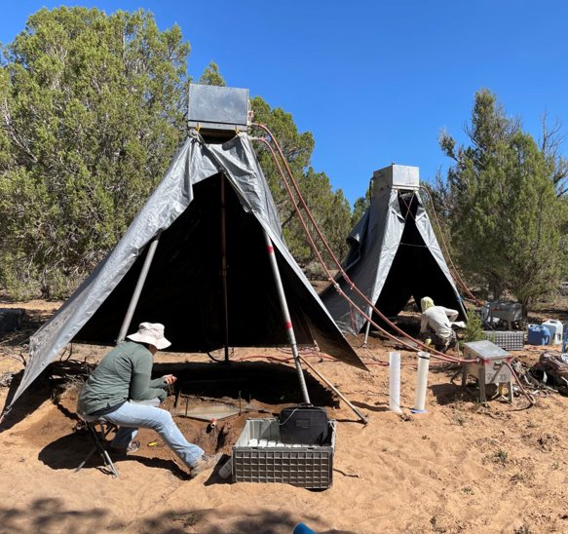
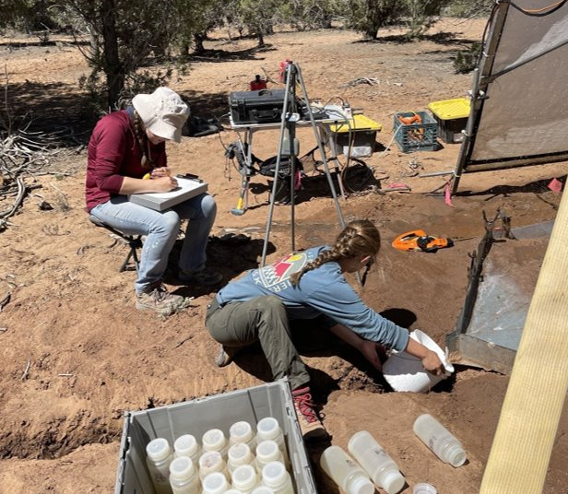
Methods
Crust cover <- line point
Runoff and Erosion <- collected timed samples of runoff from rainfall simulator and processed in lab
Erosion <- collected timed samples of sediment and dried bottles in oven

Slide 8
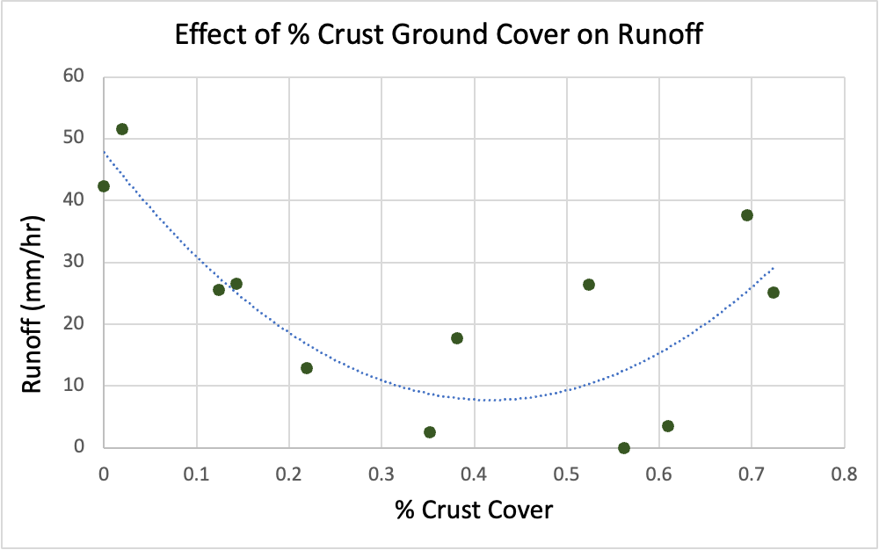
Results: Runoff
For low crust (0-20% cover) runoff decreased as crust increased
For moderate crust (20-50% cover) quantity of runoff was low
For high crust cover (50-70+% cover) runoff increased as crust increased

Slide 9
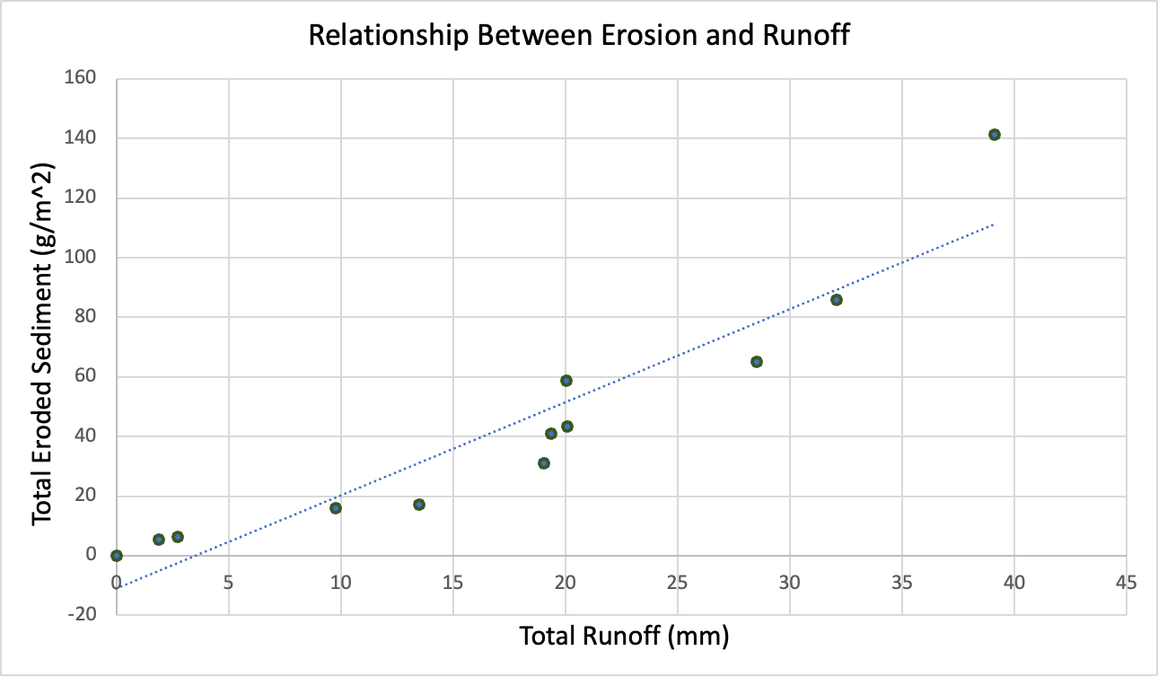
Results: Erosion
The mass of erosion was directly correlated to quantity of runoff

Slide 10
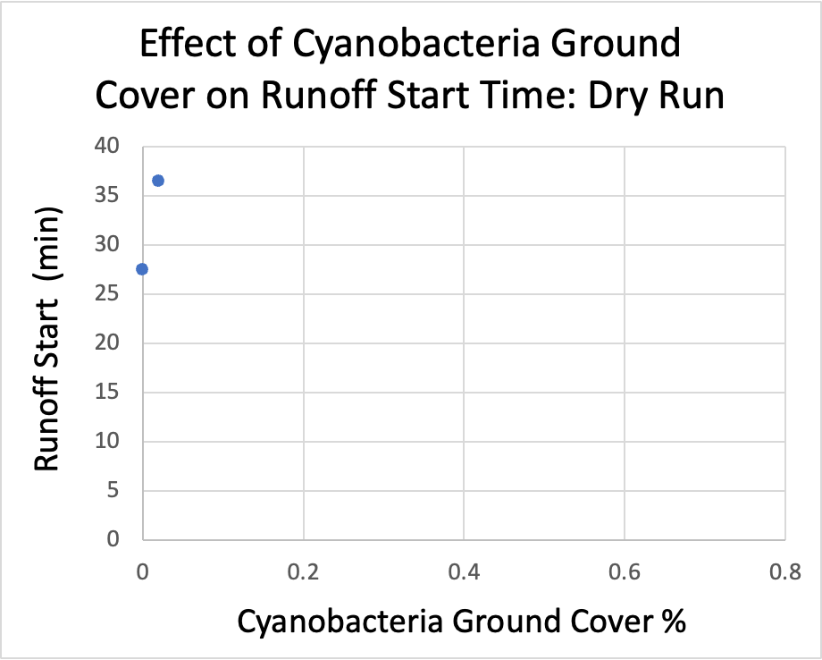
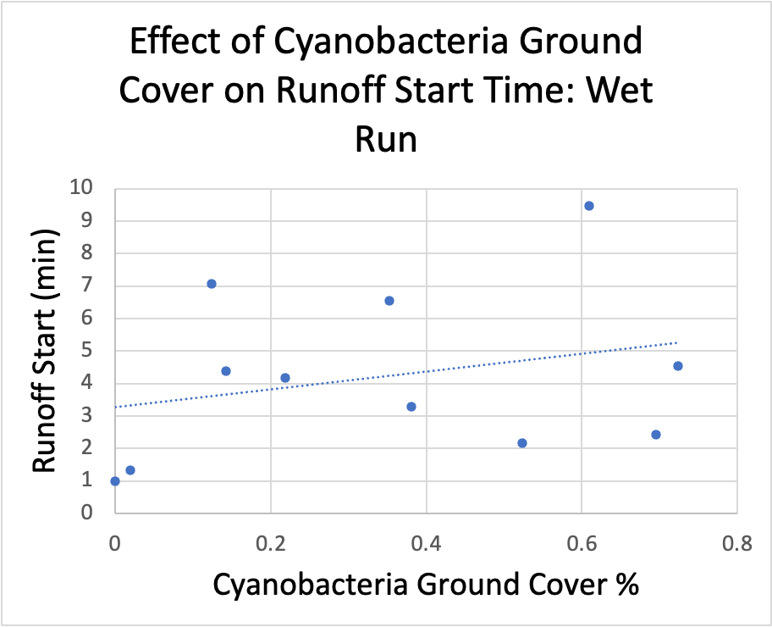
Results: Time to Runoff
Overall trend: more crust delays runoff start time
  Lightest rainfall intensity: only 2/12 plots produced runoff both had low crust cover (<20% ground cover)
  Higher rainfall intensity: runoff start time was delayed as crust cover increased

Slide 11
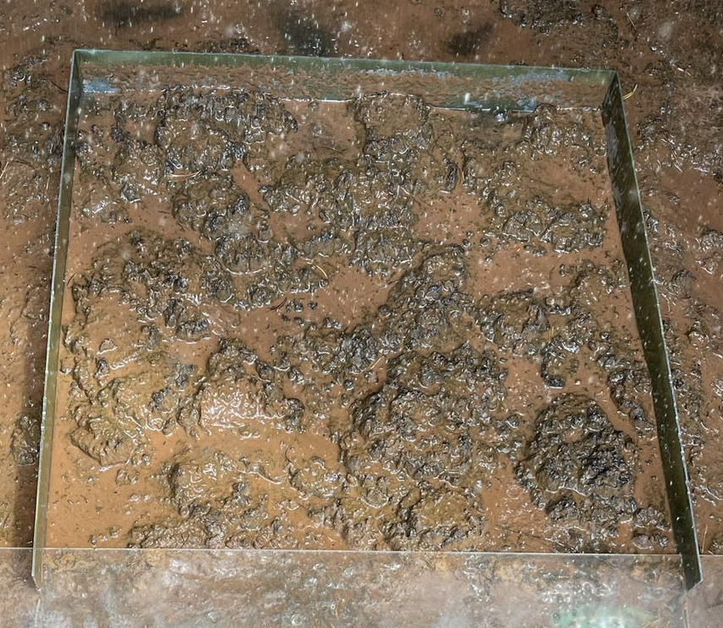
Results: Why?
What could explain our runoff curve?
Roughness (first half of curve) - statistically insignificant relationship
Pore clogging effect (second half of curve) - supported by previous literature in sandy soils

Slide 12
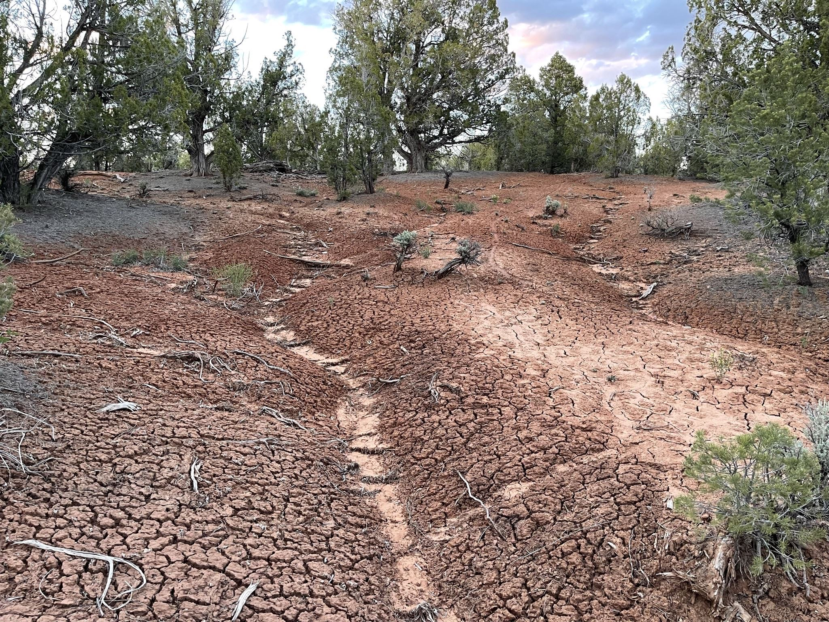
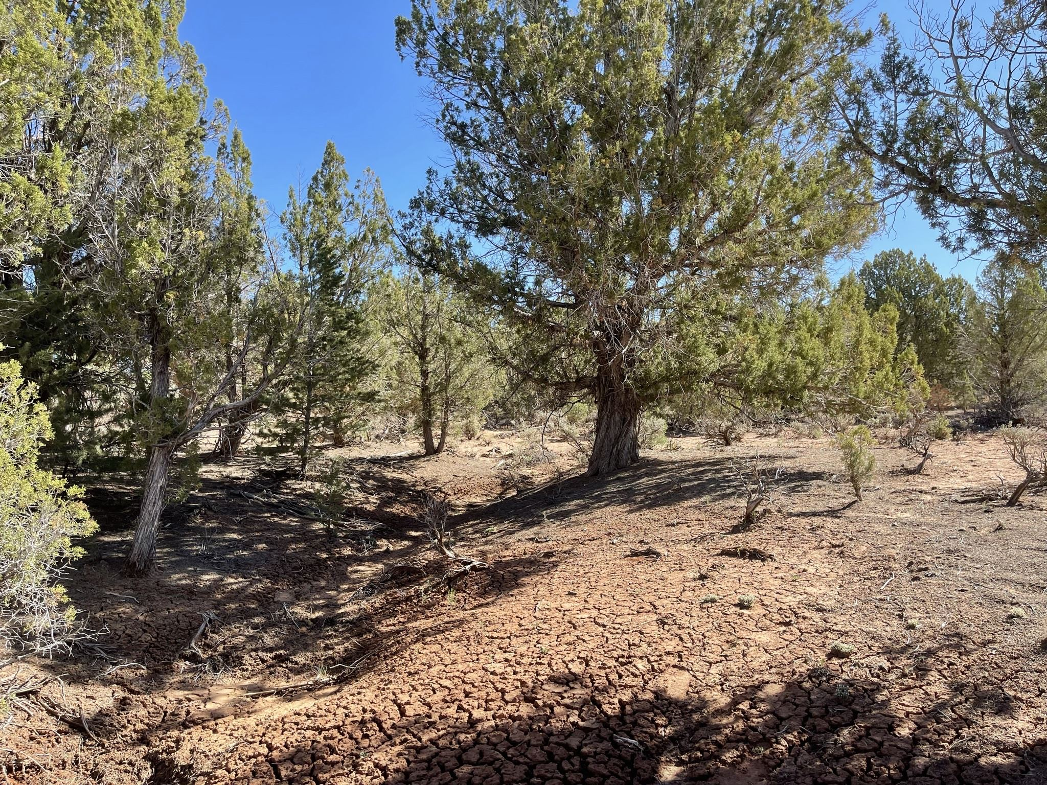
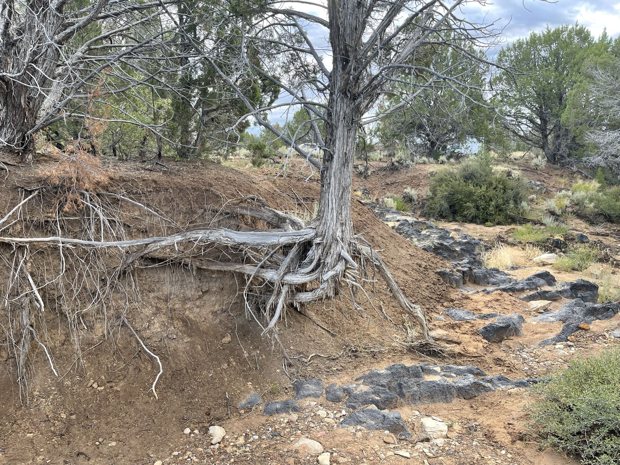
Conclusion
Crust cover is correlated to increased or decreased runoff depending on its abundance in PJ interspaces at the fine spatial scale
Erosion in these interspaces is directly correlated to runoff
This information will help land managers make decisions about preserving crust, treating other vegetation types, and preventing erosion

Slide 13
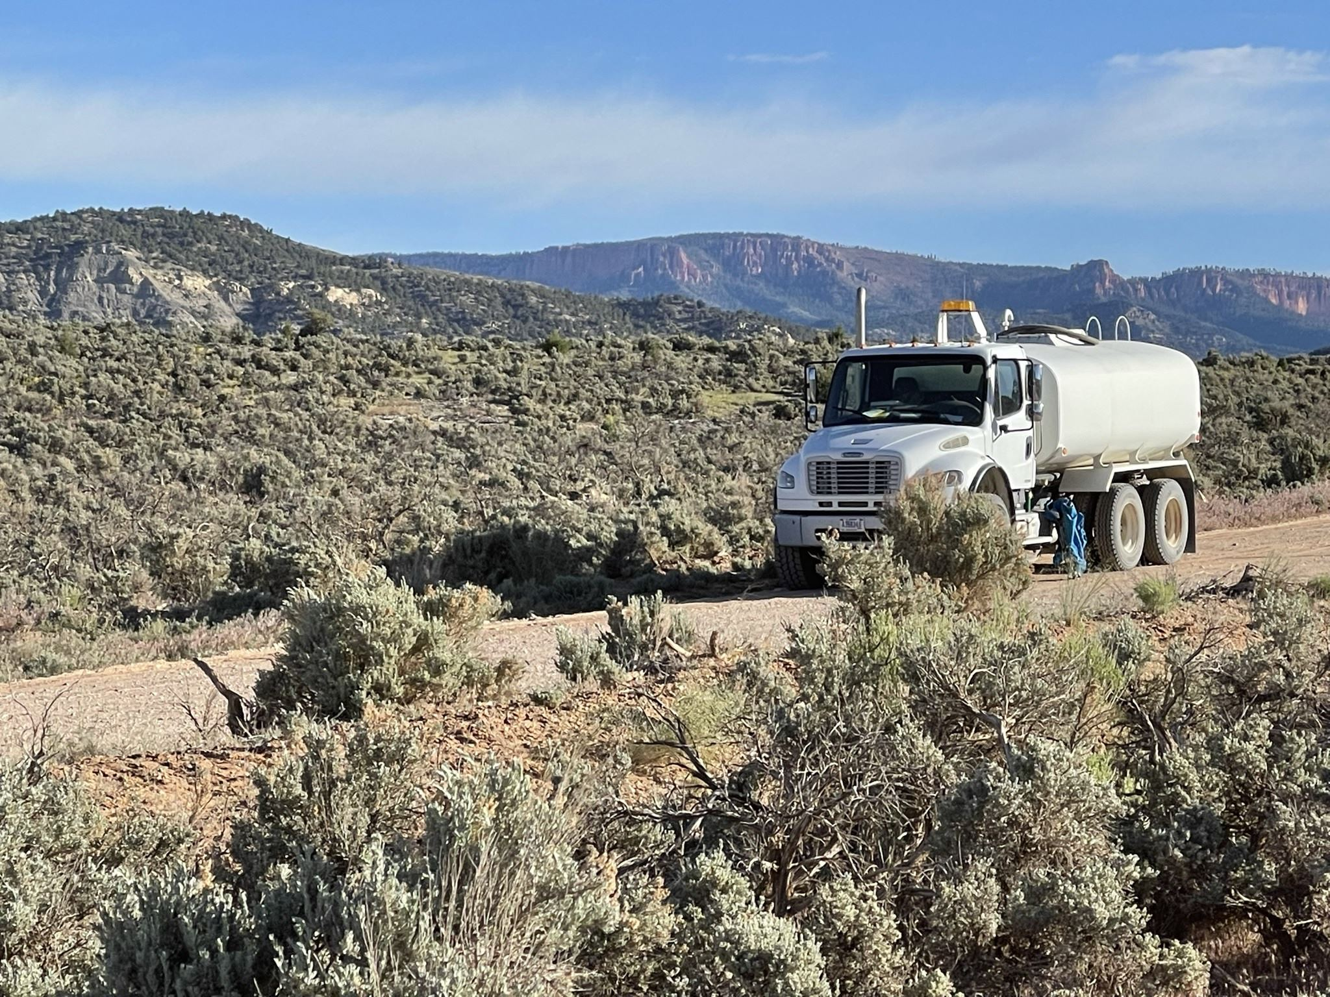
Future Direction
  Repeat design at multiple sites in GSENM
  Utilize RHEM modeling to assess the effect of crust across larger scales

Slide 14
Acknowledgements
Advisors
Dr Jason Williams, Research Hydrologist, Southwest Watershed Research Center, USDA Agricultural Research Service
Justin Johnson, Hydrologist, Southwest Watershed Research Center, USDA Agricultural Research Service
Erin Phelps, Ecohydrologist, University of Arizona
Dr Phil Guertin, Professor, University of Arizona
Funding
Arizona/NASA Space Grant Consortium
Southwest Watershed Research Center, USDA Agricultural Research Service
Grand Staircase Escalante National Monument, USDI Bureau of Land Management, Raven Chavez- Soil Scientist

Slide 15
Thank you

